Slide 1
New River Leadership Naomi Nash
Anglicare G100 October 2019:
Introduction to Psychological safety

Slide 2
Naomi Nash - Introduction

Slide 3
What is Psychological safety?

Slide 4
a shared belief held by members of a team that the team is safe for interpersonal risk taking

Slide 5
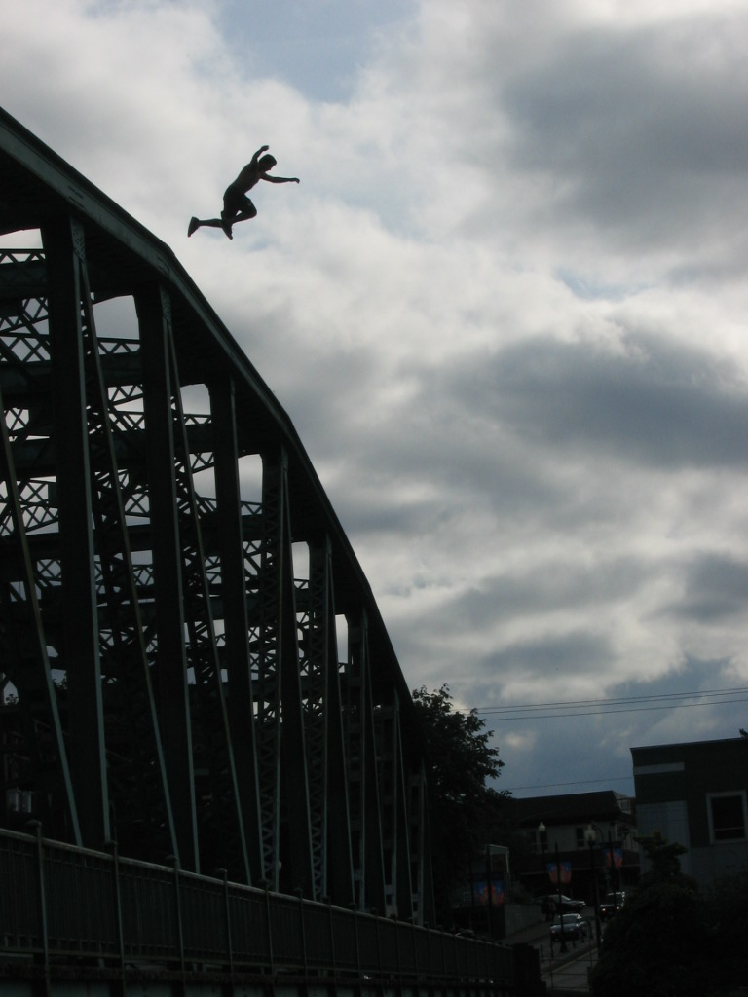
Beyond Trust

Slide 6
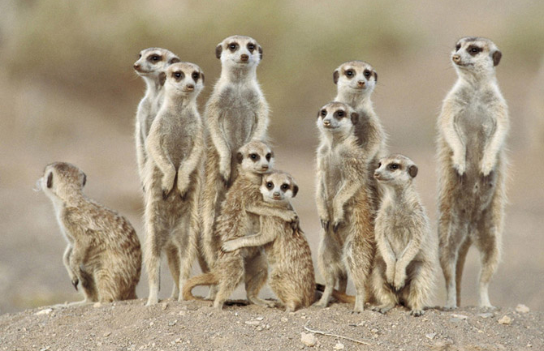
In interpersonal contexts, fear = anticipated shame

Slide 7
If I ask this question, raise this concern, admit mistake, share this idea, will I be…
Rejected
Ridiculed
Othered
Lose face by creating an unfavourable impression on people who influence decisions, promotions, raises and work assignments

Slide 8
Origins of Psychological Safety in research
Amy Edmonson’s 1999 study of error rates in hospital teams
Project Aristotle at Google

Slide 9
What becomes possible in psychologically safe teams?

Slide 10
Learning behaviours
seeking feedback
sharing information
asking for help
talking about errors
experimenting

Slide 11
Collective Intelligence
teams detect changes in the environment
learn about customers' requirements
Improve collective understanding of situations
discover unexpected consequences of previous actions,
reveal errors early and save costs

Slide 12
Collaborative behaviours
Clarity of goals
Shared purpose
Growth mindset
Contribution orientation
Vulnerability

Slide 13
Psychological safety is an antecedent to learning, innovation, wellbeing and team performance

Slide 14
“A team's history matters in shaping psychological safety. Shared beliefs about how others will react are established over time."

Slide 15
Over to you

Slide 16
Thinking about yourself and your most direct teams:
What would need to change for me to feel consistently safe at work?
What would need to change for us to be consistently safe together?

Slide 17
Where to from here?

Slide 18
“Fast-paced work environments require learning behaviour to make sense of what is happening as well as to take action. With the promise of more uncertainty and change, teams are in a position to provide an important source of psychological safety for individuals at work.
- Amy Edmonson

Slide 19
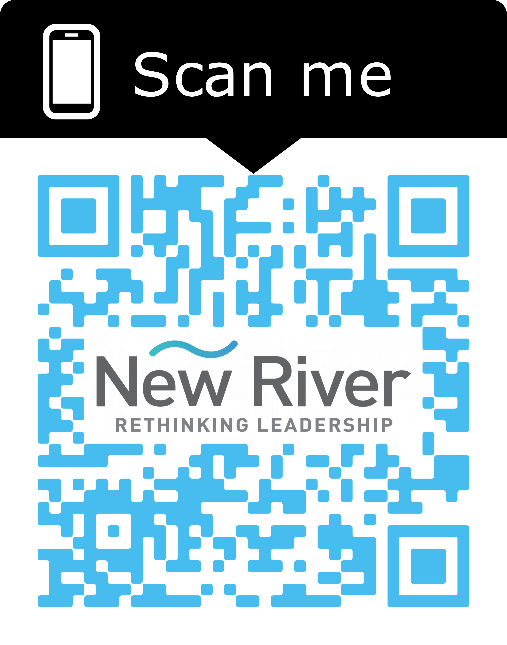
Slide Deck // Further reading

Slide 20
New River Leadership Naomi Nash
Naominash@newriver.org.au
Ph: 0407 907 849

